Slide 1
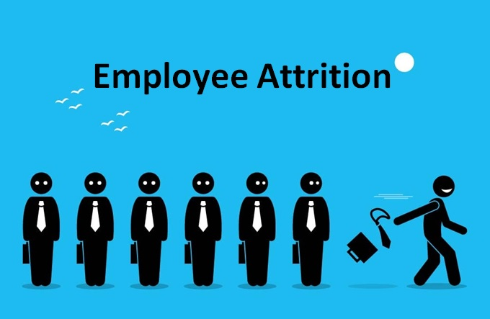
Employee Attrition Analysis

Slide 2
Project Detail
Project Title | Employee Attrition
Technology | Data Science
Domain | Travel and Tourism
Programming Language Used | Python
Tools used | Jupyter Notebook, MS-Excel, Power BI

Slide 3
Objective
Employee attrition is a critical area of concern for many organizations across various industries. It refers to the process of employees leaving the organization voluntarily or involuntarily, resulting in vacancies that require replacement. High attrition rates can lead to increased hiring and training costs, reduced productivity, and can impact team morale. Understanding and addressing the root causes of employee attrition is essential for organizations to maintain a stable and productive workforce.
Major Causes of Attrition
Employee attrition can occur for several reasons, including:
Job Dissatisfaction: Lack of motivation, poor management, or an unfulfilling job role can lead to employees leaving the organization.
Career Growth Opportunities: Employees may leave if they feel there is little scope for professional development within the company.
Work-Life Balance: Stress, long hours, and poor work-life balance can push employees to look for other opportunities.
Compensation and Benefits: If employees believe that their compensation package is not competitive, they may seek better-paying positions elsewhere.
Organizational Culture: A negative work environment or misalignment with the company’s values can drive employees to leave.

Slide 4
Problem Statement
XYZ company which was established a few years back is facing around a 15% attrition rate for a couple of years. And it's majorly affecting the company in many aspects. In order to understand why employees are leaving the company and reduce the attrition rate XYZ company has approached an HR analytics consultancy for analyzing the data they have. You are playing the HR analyst role in this project and building a dashboard which can help the organization in making data-driven decisions.

Slide 5
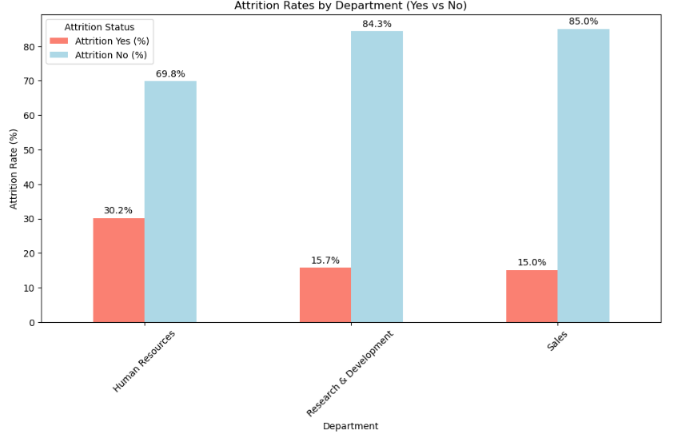
Insights
Attrition Rates by Departments
We can see that employees working in human resource are 30.2% more likely to leave which is almost double compared to other departments.

Slide 6
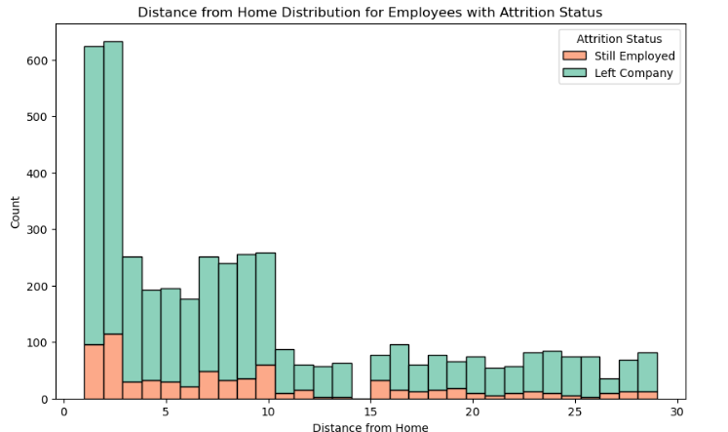
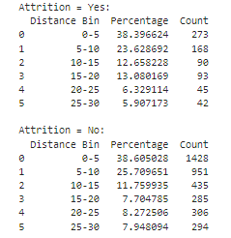
Distance from Home Distribution responsible for Employees Attrition
We can conclude that the employees at distance from company between 0-10 km are more likely to leave the company as shown by the total percentage of 62.02% but majority of them are most likely to stay as well (i.e., 64.30%).

Slide 7
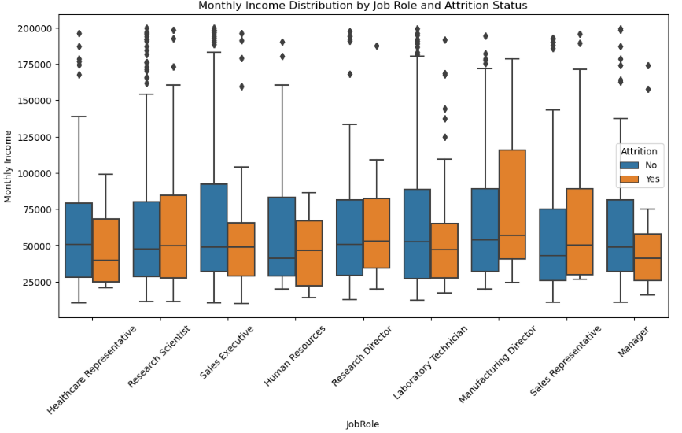
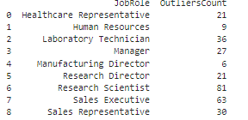
Monthly Income Distribution by Job Role to watch Employees Attrition Status
The Bar Plot and Mean and Median Values for monthly salary we can say that the job role of Manufacturing Director is the highest paying and stable job with least outliers while the monthly salary for job role of Research Scientist is more dependent on other factors.

Slide 8
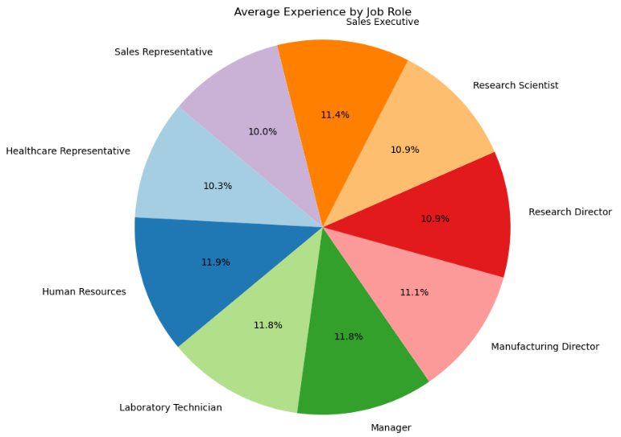
Average Experience for each Job Role
We can conclude that almost all Job Roles need same Working Experience.

Slide 9
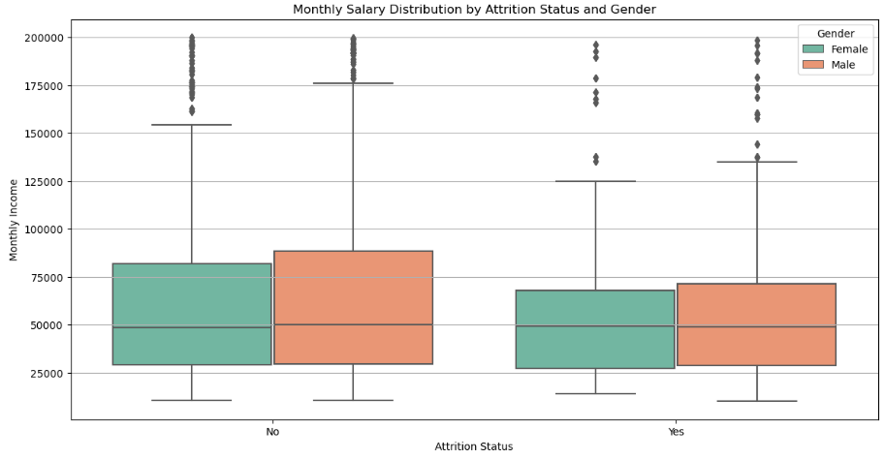
Attrition Probability of Male and Female Employees according to their Monthly Salaries
From the boxplot we can conclude that Monthly Salary doesn't significantly impact Employee attrition probability on basis of gender but those employees who earn salary of more than 70000 are less likely to leave the company compared to other employees.

Slide 10
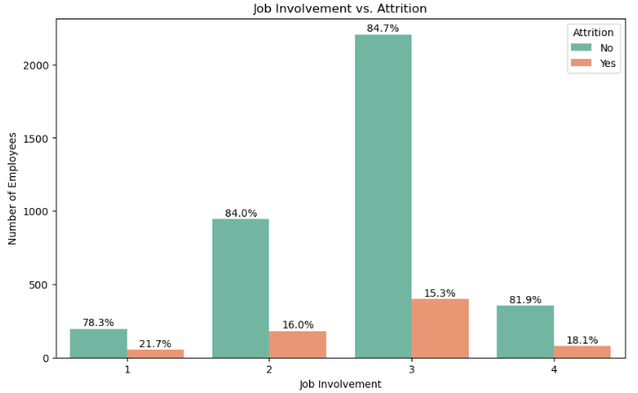
Effect of Job Employment on Employee Attrition
From the above bar plot we can conclude the Employees with more job involvement of 1 and 4 are highly likely to leave (i.e., 21.7% and 18.1% respectively) the company compared to others and most employees have job involvement rating of 3.

Slide 11
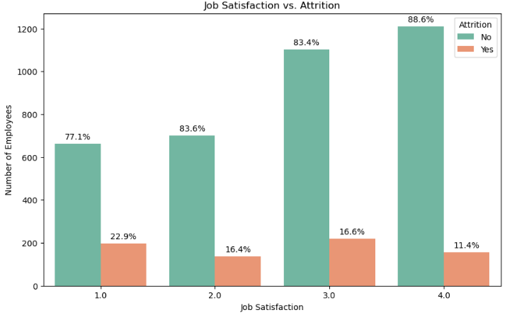
Effect of Job Satisfaction on Employee Attrition
From the grouped bar plot we can conclude that employee with least job satisfaction of 1 have 22.9% probability of leaving the company which is highest.

Slide 12
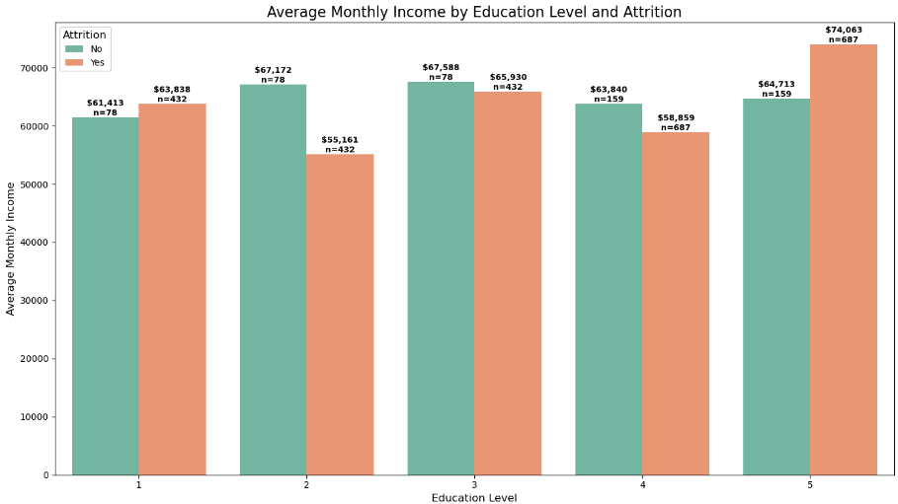
Average Monthly Income by Employee Education Level to find out which Employees are more likely to leave the company
From above grouped bar chart we can conclude that Employees with Lowest and Highest Education Level (i.e., 5) are more likely to switch jobs inspite of having high salaries (i.e., $63838 and $74063) compared to their other counterpart.

Slide 13
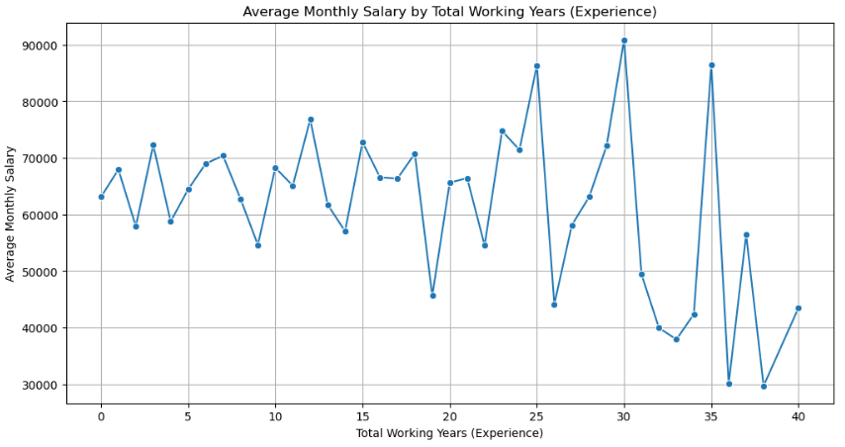
Average Monthly Salary of all Employees vs the Total Working Experience
From the line plot we can conclude that Employees with age in range of 30-40 are highly probable to see a rapid decline in their Salary.

Slide 14
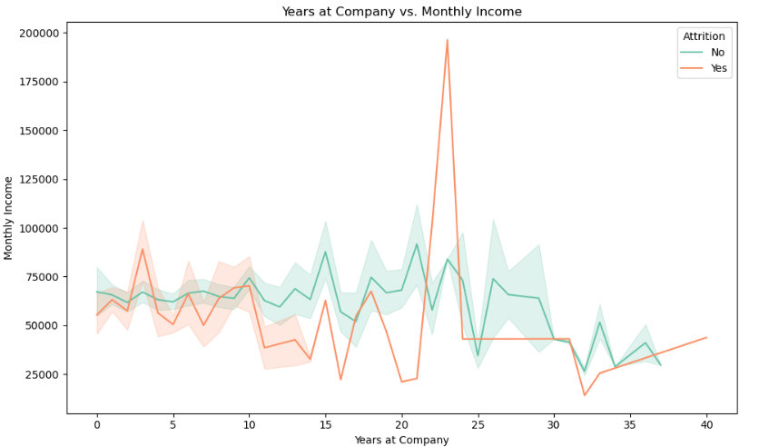
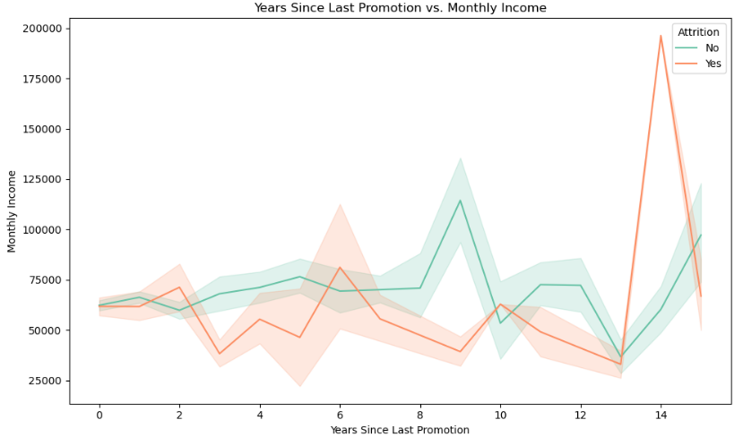
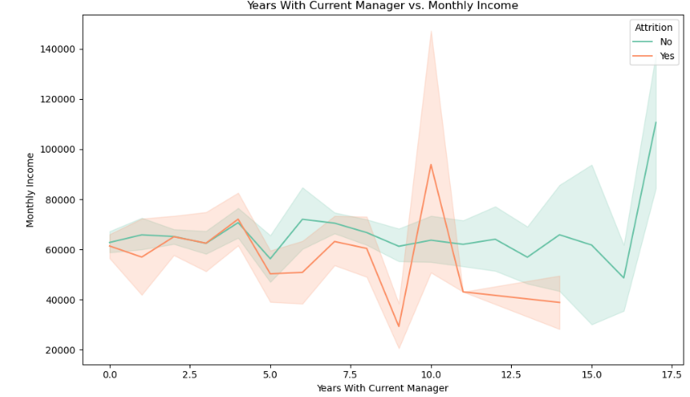
Years At Company, Years Since Last Promotion, Years With Current Manager vs Monthly Income on Attrition
From the above plots of Monthly Income with Years we can conclude that employees with high

Slide 15
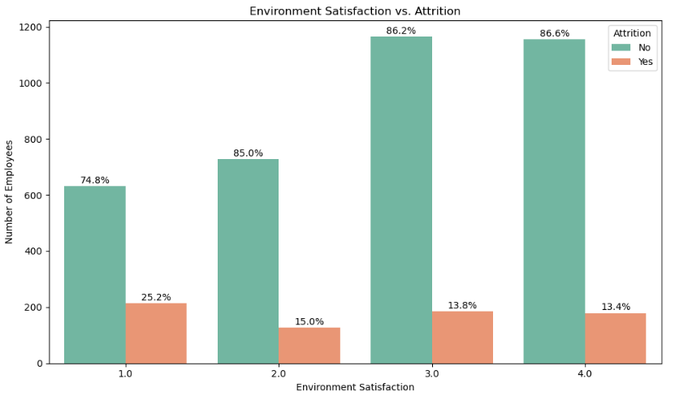
Environment Satisfaction of Employees by their Attrition Status
From the given grouped bar plot we can observe that as Environment Satisfaction increase Employees leaving the company decrease (i.e., 1->25.2%, 2->15.0%, 3->13.8%, 4->13.4%) with not significant attrition difference when Environment Satisfaction Rating is 3 and 4.

Slide 16
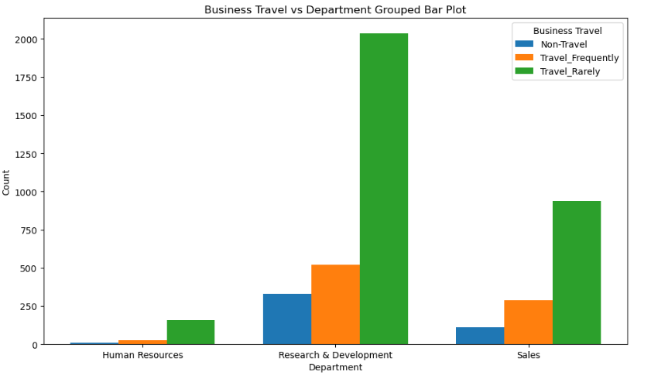
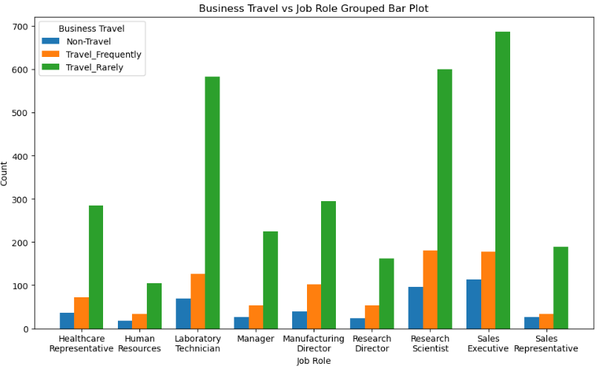
Business Travel vs Department and Job Role Grouped Bar Plot
From above plots we can observe that a major chunk of employees have to travel rarely irrespective of departments or roles followed by the count of those employees who travel frequently and then never travel respectively.

Slide 17
Conclusion
Employees working in human resource are 30.2% more likely to leave which is almost double compared to other departments.
Job role of Manufacturing Director is the highest paying and stable job with least outliers while the monthly salary for job role of Research Scientist is more dependent on other factors.
We can conclude that almost all Job Roles need same Working Experience.
Monthly Salary doesn't significantly impact Employee attrition probability on basis of gender but those employees who earn salary of more than 70000 are less likely to leave the company compared to other employees.
Employees with more job involvement of 1 and 4 are highly likely to leave (i.e., 21.7% and 18.1% respectively) the company compared to others and most employees have job involvement rating of 3.

Slide 18
Major chunk of employees have to travel rarely irrespective of departments or roles followed by the count of those employees who travel frequently and then never travel respectively.
Career stagnation (lack of promotions) appears to be a risk factor for attrition
Long-term relationships with managers can be beneficial for those who stay
The company might need to pay special attention to:
Employees approaching 20-25 years of service
Those who haven't been promoted in 8+ years
Manager-employee relationships around the 10-year mark

